Slide 1
Retail sales data analysis
Source : https://www.kaggle.com/datasets/mohammadtalib786/retail-sales-dataset
Dataset : retail_sales_dataset.csv
Email : yelagandalabhavana@gmail.com
LinkedIn : https://www.linkedin.com/in/bhavana-yelagandala-006a352b2
BHAVANA YELAGANDALA

Slide 2
Introduction
Overview of the dataset (1,000 transactions, 9 columns)
Purpose: Analyze customer demographics, product performance, and revenue trends
Tools: Python, PySpark, Pandas, Matplotlib, Jupyter Notebook

Slide 3
Dataset Description
Columns:
Transaction ID – Unique identifier for each transaction
Date – Transaction date (spanning Jan–Dec 2023)
Customer ID – 1,000 unique customers (no duplicates)
Gender – Male/Female distribution
Age – 18 to 64 years (average ~41.4)
Product Category – 3 categories: Beauty, Clothing, Electronics
Quantity – Number of units purchased (1–5 range)
Price per Unit – ₹25 to ₹1000 depending on product
Total Amount – Transaction revenue (₹25 to ₹2000, avg. ₹456)

Slide 4
Retail Sales Dataset Insights
1. Structure and Uniqueness
The dataset comprises 1,000 rows and 9 columns. Each transaction is uniquely identified by a Transaction ID. Similarly, each customer has a unique Customer ID, ensuring one record per transaction per customer. The dataset captures both demographic attributes (gender, age) and transactional details (category, quantity, price, amount), providing a well-rounded foundation for sales analytics.
2. Product Categories
There are three product categories represented: Beauty, Clothing, and Electronics. Clothing is the most frequently purchased, followed by Beauty, while Electronics has relatively fewer but possibly high-value transactions. This indicates customer preference is skewed toward lifestyle products, though electronics may contribute more to revenue per unit.

Slide 5
RETAIL SALES DATASET INSIGHTS
3. Gender Distribution
The dataset has a fairly balanced gender split:
Female Customers: 510 (51%)
Male Customers: 490 (49%)
This near-equal distribution indicates that marketing strategies can be applied uniformly across genders without heavy skew.
4. Age Distribution
Customer ages range from 18 to 64 years, with an average age of 41.4 years.
Younger customers (18–25) form a smaller share but may be associated with lower transaction values.
Mid-aged customers (30–50) dominate the dataset, likely contributing to stable, consistent sales.
The spread suggests that the business appeals to a broad demographic, but middle-aged buyers are the core segment.

Slide 6
RETAIL SALES DATASET INSIGHTS
5. Revenue Insights
The Total Amount (transaction revenue) ranges from ₹25 to ₹2,000, with an average of ₹456.
The distribution is moderately skewed, as most transactions are of moderate value, but there are notable high-value purchases.
Such high-value outliers are more likely linked to electronics or bulk clothing orders.
The variability in spending suggests opportunities for customer segmentation (e.g., budget vs. premium shoppers).
6. Key Relationships
Quantity vs. Revenue: Strong positive correlation, as expected — larger orders generate higher revenue.
Price vs. Revenue: High-priced items significantly influence total transaction amounts, especially in the Electronics category.
Age vs. Revenue: Middle-aged customers tend to spend more, indicating a relationship between age and purchasing power.

Slide 7
RETAIL SALES DATASET INSIGHTS
7. Business Characteristics
Overall, the dataset represents a balanced and clean retail dataset capturing customer demographics, purchasing behavior, and transaction amounts. Its completeness makes it suitable for predictive modeling, customer segmentation, and revenue forecasting. It highlights:
Strong presence of mid-aged buyers.
Balanced gender contribution.
A mix of low-value frequent sales (Beauty, Clothing) and high-value occasional sales (Electronics).

Slide 8
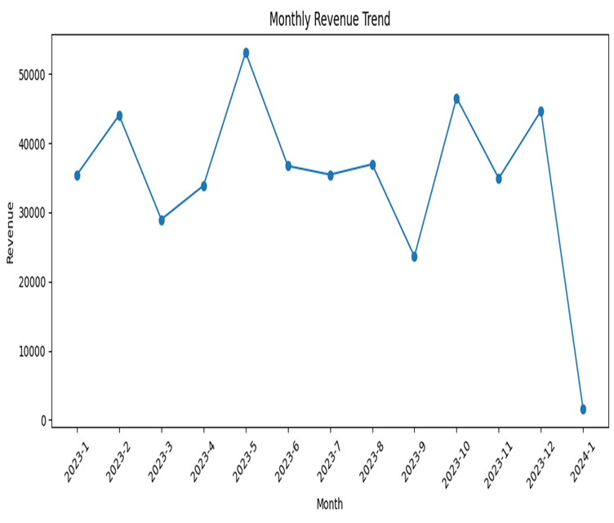
Monthly Revenue Trend (Line chart)
Monthly revenue shows clear fluctuations, with major peaks in May and October 2023 driven by seasonal demand. Revenue dips in March and September, while January 2024 is low due to incomplete data. Overall, sales remain steady between ₹30,000–₹40,000 across most months.

Slide 9
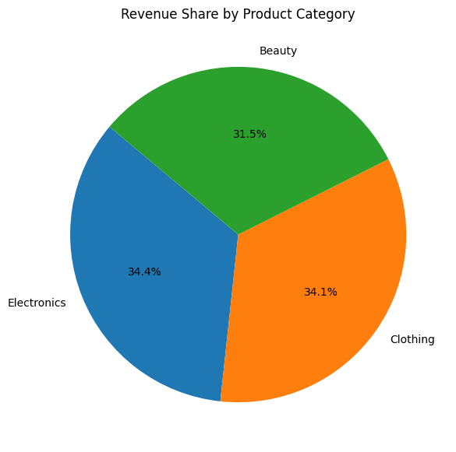
Revenue share by product category (pie chart)
Revenue is almost evenly distributed across categories — Electronics (34.4%) and Clothing (34.1%) lead slightly, while Beauty contributes 31.5%. This balance shows all three categories are strong revenue drivers with near equal importance.

Slide 10
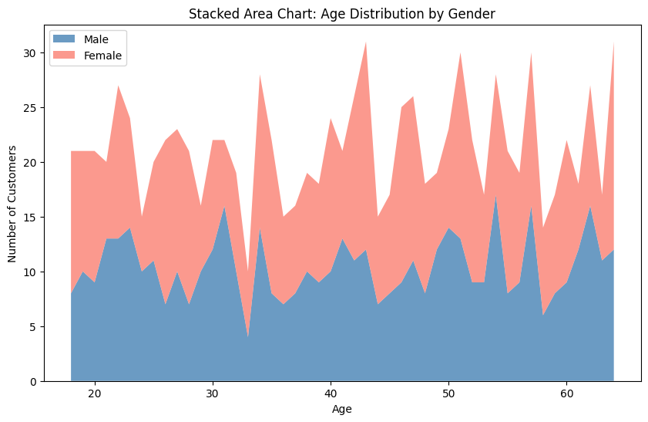
Age distribution by gender (stacked area chart)
The stacked area chart shows customer age distribution by gender. Both male and female customers are fairly balanced across all age groups, with slight variations in certain ranges, indicating no strong dominance of one gender over another.

Slide 11
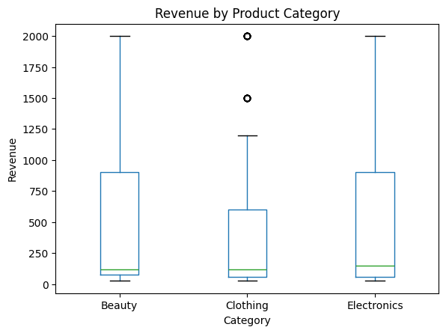
Revenue by product category (BOX PLOT)
The boxplot shows that revenue varies widely across all categories. Electronics and Beauty have higher revenue ranges with some extreme values, while Clothing has lower median revenue but notable outliers. This indicates Electronics and Beauty drive more high-value sales compared to Clothing.

Slide 12
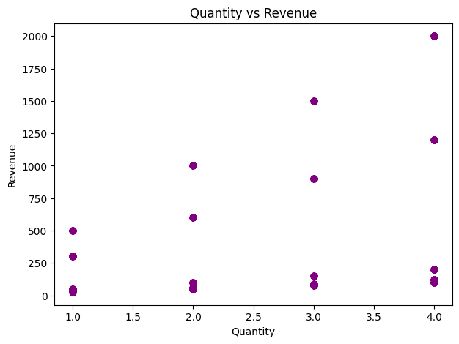
Quantity vs revenue (SCATTER PLOT)
The scatter plot shows a clear positive relationship between quantity and revenue. Higher quantities (3–4 units) are linked with higher revenue values, including the maximum around ₹2000, while single-unit purchases generally yield lower revenues.

Slide 13
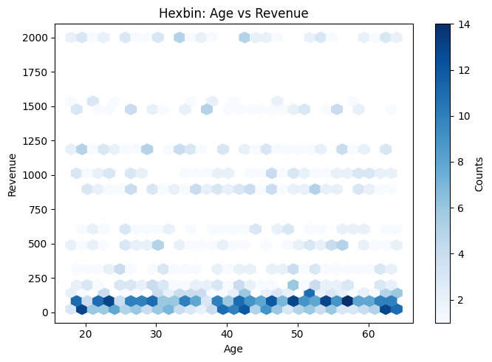
Age vs revenue (HEXBIN)
The hexbin plot shows that most customers, regardless of age, generate low-to-moderate revenues clustered below ₹250. Higher revenues (above ₹1000) are scattered across all age groups, with no strong concentration in any single age range.

Slide 14
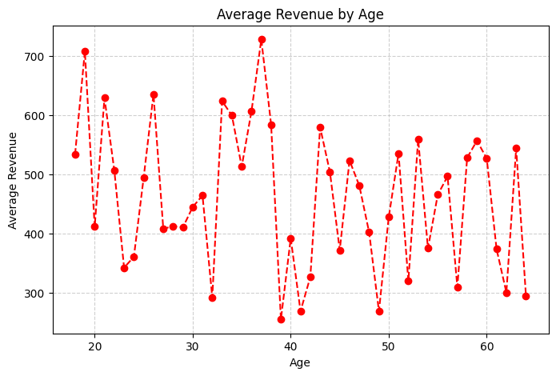
Average revenue by age (LINE PLOT)
The line plot shows fluctuations in average revenue across ages. Younger customers (18–25) and mid-aged groups (30–40) show higher peaks, while revenue stabilizes at moderate levels among older age groups. This suggests younger and mid-aged buyers tend to drive higher spending.

Slide 15
Key findings
Clothing dominates sales volume
Electronics drive high-value purchases
Mid-aged customers are the top spenders
Revenue distribution shows both low- and high-value customers

Slide 16
Code Walkthrough: Data Loading
Used PySpark to read the retail sales CSV dataset into a DataFrame.
Schema inferred automatically from the header row.
Verified column types and structure using printSchema().
Previewed dataset with show() to check initial records.

Slide 17
Code Walkthrough: transformations
Converted the Date column into proper DateType for time-based analysis.
Created a new Revenue column (Quantity × Price per Unit) for financial insights.
Handled duplicates and ensured no missing/null values.
Aggregated data for monthly revenue trends and product category statistics.
Filtered high-value transactions above average revenue for deeper analysis.

Slide 18
Code Walkthrough: Visualizations
Pie Chart: Revenue share by product category (Electronics, Clothing, Beauty).
Line Plot: Monthly revenue trend highlighting seasonal peaks and drops.
Stacked Area Chart: Age distribution by gender of total customers.
Boxplot: Revenue variation across product categories with outliers.
Scatter Plot: Relationship between Quantity and Revenue.
Hexbin Plot: Age vs. Revenue density visualization for spending patterns.

Slide 19
conclusion
This project successfully applied PySpark and data analytics techniques to a retail sales dataset of 1,000 transactions. Through systematic exploration and visualization, we uncovered key business insights: The results highlight opportunities to target mid-aged premium buyers while engaging younger customers through promotions, ensuring sustainable growth. This retail sales dataset reveals a balanced customer base by gender and a strong mid-aged segment (30–50 years) driving the majority of revenue. Clothing contributes most transactions, while Electronics generate high-value purchases, highlighting opportunities for differentiated marketing. Overall, the dataset is clean, consistent, and provides a solid foundation for customer segmentation, trend forecasting, and targeted business strategies.

Slide 20
THANK YOU

